Slide 1
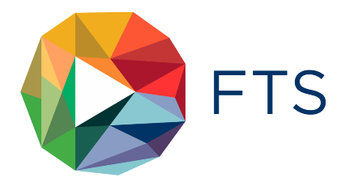
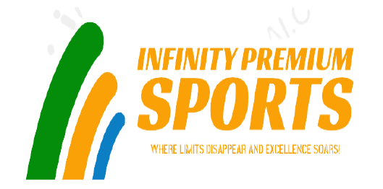
SYST8200 - CAPSTONE PROJECT GROUP 2

Slide 2
Project analysis slide 8
Capstone Project
INTRODUCTION
Float-Tech Solutions aids businesses in making the most of cloud technology. It provides solutions using Microsoft Azure, Amazon Web Services and other clouds platforms . Float-Tech's expertise are in areas like multi-cloud infrastructure, data analytics, application development and security helps clients grow their business.
The main purpose of this project is advising Infinity Premium Sportswear, a global athletic apparel brand to migrate its on-premises infrastructure to the cloud platform by comparing best cloud service provider and its services.
Infinity Sports is a firm which sells and distributes various sports gear. They provide equipment to customers, and athletes who participate in events.

Slide 3

Project analysis slide 8
Capstone Project
FTS CORE TEAM MEMBERS
CLOUD ARCHITECT
CLOUD ENGINEER
VENKATA SAI RAMESH SEERAPU
An expert in planning and designing the cloud architecture along with seamless migration transition.
JAISHAANTH SURESH
A skilled professional who leverages his technical expertise in managing cloud solution , technologies and troubleshooting.
CLOUD FINANCIAL ANALYST
CLOUD SECURITY ANALYST
PROJECT MANAGER
GOUTHAM REDDY BADDAM
A dedicated professional who looks into the finances, performance and usage metrics.
NIKITA DHINGRA
An expert in implementing robust security measures and protecting company’s assets and data.
MEHUL JAIN
A result-oriented manager specialised in planning, coordination, managing of the team and client.

Slide 4
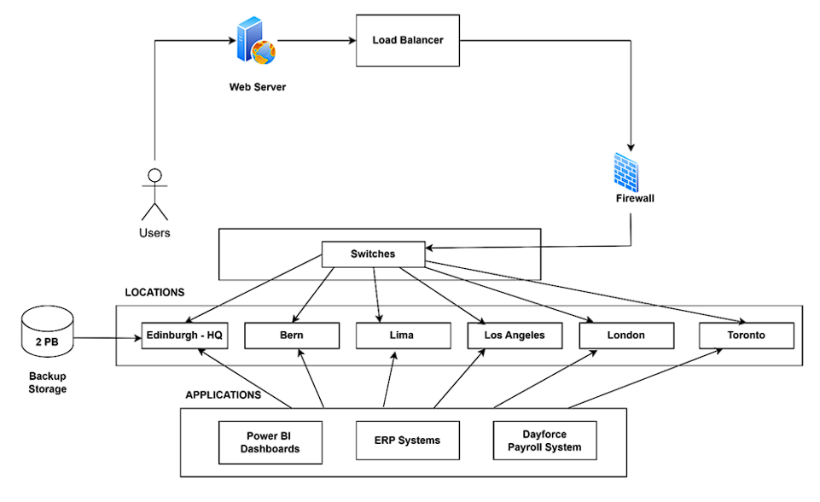
Project analysis slide 8
Capstone Project
CURRENT ARCHITECTURE
With six locations, Infinity Premium Sports Company has its headquarters in Edinburgh.
There are virtualized environments and servers that the company has purchased, which are typically around 10 years old. The project has a $200 000 OPEX and a $500 000 CAPEX.

Slide 5
Project analysis slide 3
Capstone Project
CHALLENGES
Infrastructure Deterioration
Limited Scalability and agility
Backup and Storage
Limited Disaster Recovery Capability
CUSTOMER SUPPORT THROUGH
ARTIFICIAL INTELLIGENCE
Budget Restraints

Slide 6


Project analysis slide 8
Capstone Project
ABOUT CLOUD
PROS
CONS
Higher Scalability and Flexibility
Automatic Updates and Maintenance
Innovation and Agility
Accessibility and Collaboration
Cost Effective
Vendor Lock-in
Data Deletion Cost
Dependencies on Internet

Slide 7
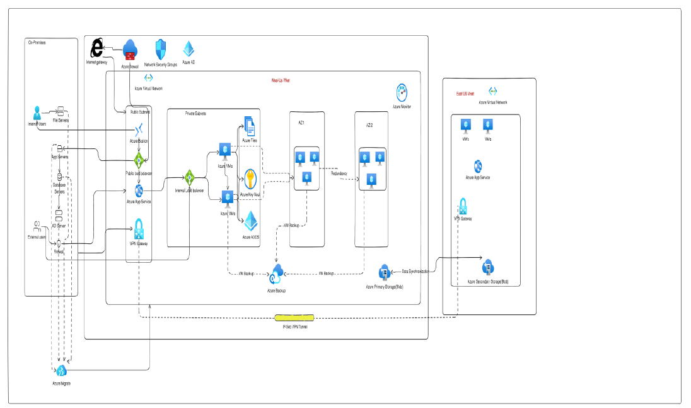
Project analysis slide 8
Capstone Project
AZURE BASED SOLUTION ARCHITECTURE

Slide 8
Project analysis slide 8
Capstone Project
BENEFITS: AZURE BASED SOLUTION
Microsoft Ecosystem Integration
It works easily with Microsoft products like Microsoft 365 and other Microsoft applications. This provides a consistent user experience and simplifies data transmission between on-premises and cloud apps.
Ease of Use for Windows-Based Workloads
Azure is known for being user-friendly, particularly for Windows-based workloads and applications.
Digital Workplace Strategies Microsoft Azure and 365 provides opportunities for collaboration, communication and digital transformation. They are a key enabler of a successful digital workplace and employee experience strategy.
Better Costing
Azure fits better here as compared to AWS, because cost wise Azure is budget friendly not only big organizations but, also for small-scale companies.

Slide 9
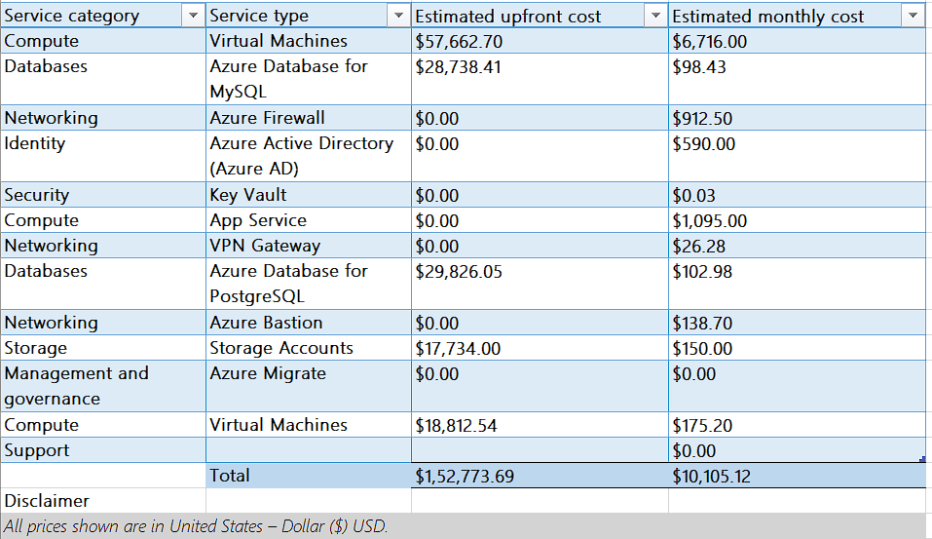
Project analysis slide 8
Capstone Project
Financial Analysis

Slide 10
Project analysis slide 8
Capstone Project
Conclusion
In this project, we effectively migrated a sports firm's traditional on-premise infrastructure to the cloud by leveraging numerous Microsoft Azure services. The primary purpose of the migration was to improve cost efficiency, performance, and scalability.
By embracing the cloud-based Azure platform, the sports company was able to optimize its IT infrastructure and substantially reduce the requirement for physical servers. This resulted in cost savings in both operational and capital expenses (OPEX), allowing the business to more efficiently allocate resources.
Furthermore, because of the cloud's intrinsic scalability, the sports organization was able to sustain rapid commercial expansion without being limited by hardware constraints. They could now scale resources up or down based on shifting needs, ensuring peak performance and cost savings during quieter periods.

Slide 11


THANK YOU

